Slide 1
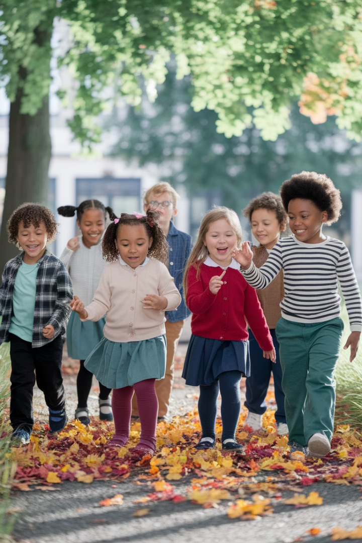

Environmental Choices: Teaching First Graders About Their Impact
This presentation outlines a comprehensive lesson plan for Grade 1 students focused on the central idea that "The choices people make can impact the environment." The lesson integrates Language, Science, Social Studies, and Arts within the PYP transdisciplinary theme of "Sharing the Planet."
Through hands-on activities, critical thinking exercises, and reflection opportunities, students will develop an understanding of environmental pollution, responsible choices, and their personal agency in creating positive change. The lesson builds on students' prior knowledge while preparing them for deeper exploration of environmental concepts.
by Deepthi Rani Bheemkar

Slide 2






Lesson Foundations & Rationale
Real-World Relevance
Connects to students' daily lives
PYP Concepts
Responsibility, causation, change
Student Development
Builds ATL skills and agency
This lesson was chosen for its authentic connection to the "Sharing the Planet" transdisciplinary theme, focusing on how people share finite resources. The topic grounds inquiry in real-life contexts that are meaningful to young learners, while developing their approaches to learning skills.
The lesson builds on students' existing awareness of basic environmental concepts like keeping surroundings clean, the importance of trees, and conserving resources. It prepares them for deeper exploration through future sorting tasks, journaling, and group discussions.

Slide 3
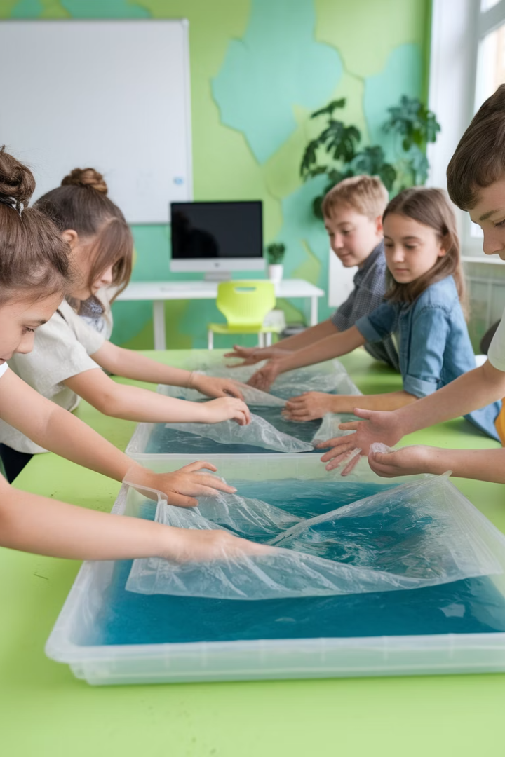




Learning Objectives & Key Concepts
Identify Environmental Pollution
Students will recognize and describe basic forms of pollution in their environment
Understand Cause and Effect
Students will demonstrate understanding of how human choices affect the environment
Categorize Needs vs. Wants
Students will sort items and connect overuse to environmental harm
Take Personal Action
Students will reflect on responsible choices and commit to one environmental action
The lesson incorporates three key IB concepts: Responsibility (recognizing how actions affect the environment), Causation (understanding how careless actions cause lasting harm), and Change (witnessing how pollution transforms environments and how positive actions can restore them).

Slide 4
Inquiry Questions & Approaches to Learning
Driving Questions
Thinking Skills Development
What is pollution?
Students will apply critical and creative thinking during activities, analyzing causes of pollution and reflecting on preventative actions. They'll practice classification through sorting tasks and understand cause-effect relationships through hands-on experiences.
How do I hurt or help the Earth?
Why is throwing trash bad?
Can I really make a difference?
Where does water and air come from?
These approaches support first graders' natural curiosity and emerging ability to make connections between their actions and environmental impacts.
What happens when we waste things?
How can I help animals and trees?

Slide 5
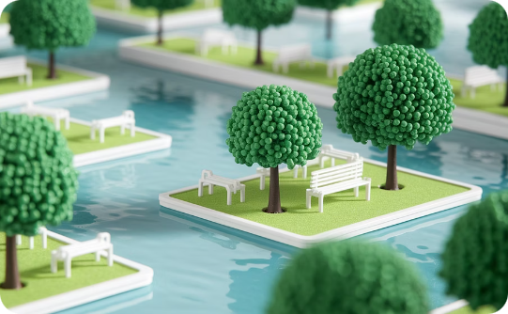
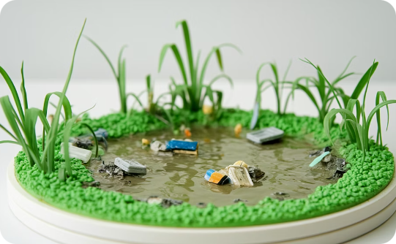
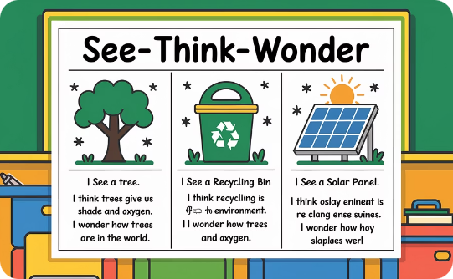
Lesson Opening: Contrasting Environments
Clean Environment Diorama
Polluted Environment Diorama
See-Think-Wonder Routine
Students explore a pristine park scene with healthy trees, clean water, and thriving wildlife, prompting positive observations and emotional connections.
Students record observations, thoughts, and questions about both environments, stimulating curiosity and empathy while introducing key concepts of causation, change, and responsibility.
The contrasting polluted scene shows litter, murky water, and damaged plants, helping students visualize environmental harm and its consequences.

Slide 6
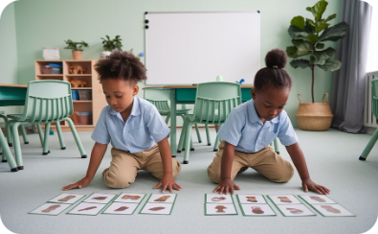
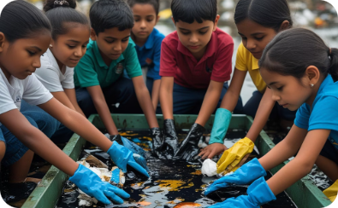
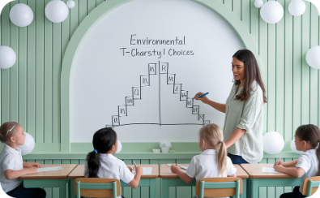
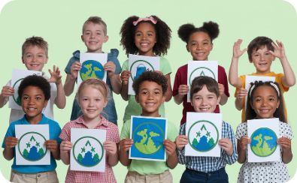
Main Activities: Hands-On Learning
Needs vs. Wants Sorting (10 min)
Pollution Cleanup Simulation (15 min)
Analyzing Materials from Water Cleanup (5 min))
Student Expression (10 min)
Students work in pairs to categorize picture cards, reflecting on how reducing unnecessary wants protects natural resources. This prepares them to understand responsible consumption.
Using two water trays (one clean, one polluted with oil, dirt, and debris), students attempt cleanup with tools like tweezers and strainers, discovering how difficult pollution reversal can be.
Students choose to create a "Pollution Hero" skit, environmental slogan, or mini-poster contrasting good and bad behaviors.
Students examine the waste removed from the polluted water tray, sort and label it by type (e.g., plastic, paper, food), and discuss real-life sources. They record their findings on a class chart.

Slide 7

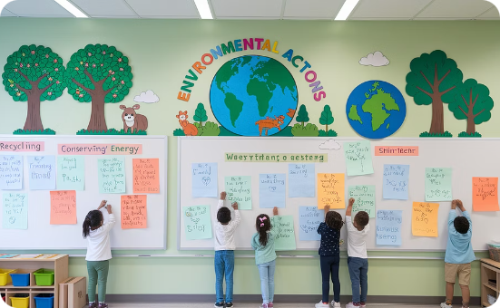
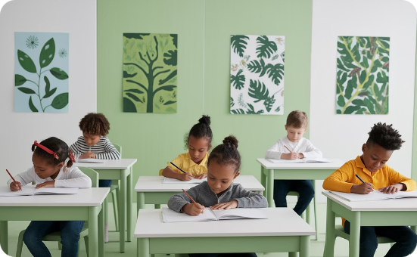
Conclusion & Reflection
Guided Reflection
Action Wall
Environmental Journals
Students answer key questions: "What can I do to help the Earth?" and "How did it feel to clean the polluted water?" These prompts encourage personal connection to the learning experience.
Each student writes or draws one specific action they commit to taking, adding it to the classroom "Action Wall" as a visual reminder of collective responsibility.
Students begin tracking thoughts, questions, and actions in journals that will continue throughout the unit, supporting ongoing reflection and documentation of learning.
This conclusion reinforces the lesson's key concepts while empowering students to take meaningful action. The reflection process helps solidify their understanding of environmental impact and personal responsibility, preparing them for deeper exploration in subsequent lessons.

Slide 8
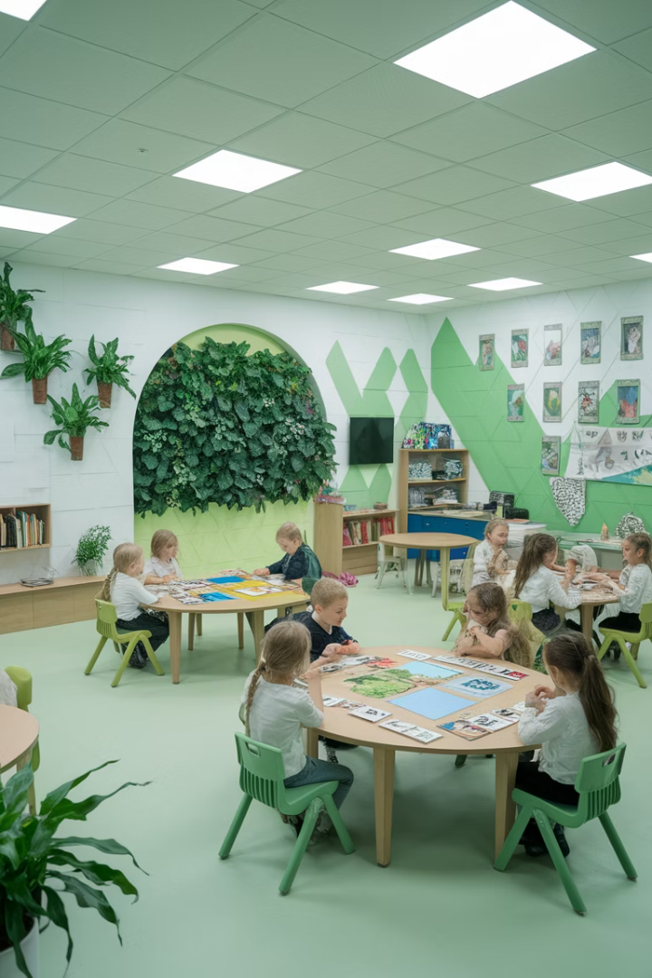




Next Steps & Resources
Reflection
Deepen understanding through discussion of pollution cleanup experience
Extension
Build skills through sorting tasks and journaling activities
Summative Task
Create posters, role-plays or videos showing responsible choices
Real-Life Action
Apply learning through meaningful environmental actions
The lesson is supported by key IB resources including "The Learner" (pages 4-6, 24-26) for student agency and profiles, "Learning and Teaching in the PYP" (pages 12-13, 29, 57) for inquiry approaches, and Harvard's Visible Thinking Routines for the See-Think-Wonder activity.
Following this lesson, students will strengthen their thinking and communication skills through additional activities that prepare them for summative assessment tasks while developing the Caring and Balanced learner profiles.

Slide 9
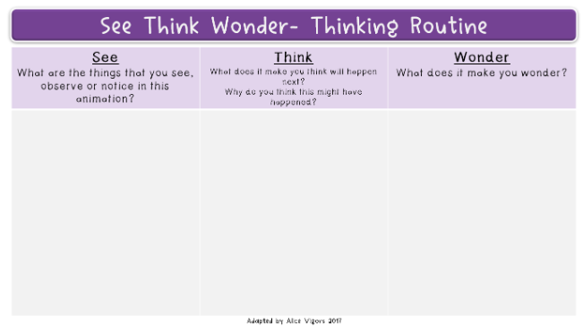
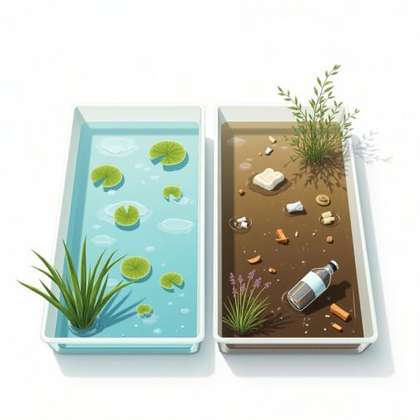
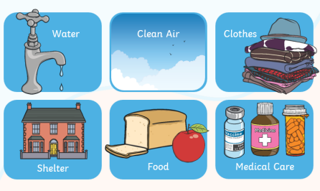
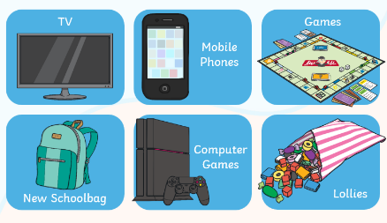
Resources:
Tweezers, gloves,empty trays to collect samples,nets
Basic Stationery: Sticky notes, pencils, charts, colour pencils, crayons, markers
Worksheets: SEE, THINK, WONDER worksheets
Flash cards: Needs Vs Wants
Needs Vs Wants Flash cards
Water trays with clean water and polluted water

Slide 10
My Reflection
I used to think... | lesson planning was mainly about listing activities and objectives.
Now I think... | effective lesson planning is about aligning learning experiences with key concepts, learner profile traits, and ATL skills to deepen understanding.
I Wonder | how I can further use student voice in shaping daily learning intentions and success criteria in future units.

